Slide 1
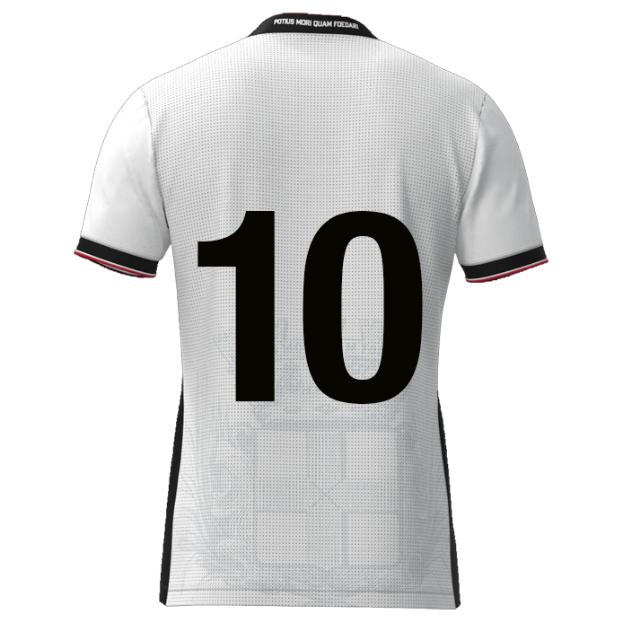

Slide 2

Browse
Foto
DATE: DD-MM-JJJJ
Player name
DD/MM/YYYY: Game / Training
DD/MM/YYYY: Game / Training
DD/MM/YYYY: Game / Training
DD/MM/YYYY: Game / Training
DD/MM/YYYY: Game / Training
DD/MM/YYYY: Game / Training
DD/MM/YYYY: Game / Training
xx
xx%
Composure
Deep runs
Offensive positioning
Powerplay
Stamina
Determination
xxxx
Scoring nr. 10
9
11
7
xxxx
8
10
6
xxxx
xx
xx
xx
xx
5
2
4
3
xxxx
1
xxxx

Slide 3
S | Rating | Multiplication factor | Result
Composure | 0 | 1,1 | 0
Deep runs | 0 | 1,1 | 0
Offensive positioning | 0 | 1 | 0
Powerplay | 0 | 1 | 0
Stamina | 0 | 1 | 0
Determination | 0 | 1,1 | 0
 |  | Average rating | 0,00

Slide 4
Scoring #10
9
11
7
Composure
Determination
10
8
Deep runs
6
5
2
4
3
Offensive positioning
Powerplay
1
Stamina

Slide 5
Composure
Deep runs
Offensive positioning
Power play
“Calm and controlled under
pressure, to make good decisions
and execute skills accurately”
“Forward runs starting from a deeper position on the field, usually from midfield or defense, moving into attacking areas”
“Attempts by physical strength and forceful challenges to dominate opponents in duels”
“Ball receptions in halfspace
and/or final third”
Danger zones
Overview
(Body)position
Goal oriented
Goal attempts
Between the posts
End result
?
Timing
Direction
Speed level
Recognition
Starting position
Sacrifice run
Frequency?
End result
?
Space recognition
Scanning
Awareness
Overload / 3rd man
Reachable
Rotating
Areas of play
?
Strong body part
Groundduels
Aerial duels
Timing
Preparation
Frequency?
End result
?
Stamina
Determination
“Sustain prolonged effort and maintain performance throughout a match without excessive fatigue”
“Showing strong will, persistence, and commitment to succeed, even in difficult situations”
Intensity
Total distance
HI-runs
Sprints
Maintaining 90 mins
Average mins p/g
?
Emotion control
Behaviour (by result)
Mourning
Inspiring others
Never give up
Fight until the end
Always 100%
?

Slide 6



